Slide 1
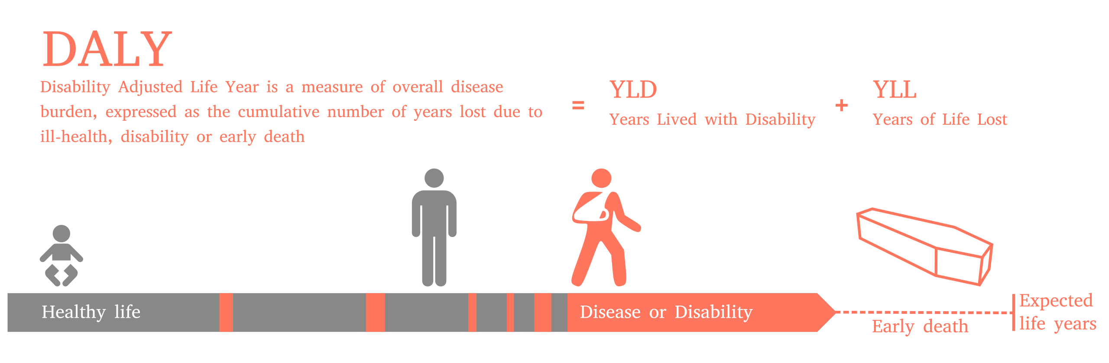
Disability weights:
Perfectly healthy: 0
Dead: 1
Disease or disability: in between
Calculating years lived with disability:
Duration with disease X disability weight
0.3*0.5 = 0.18 YLD
30% disability weight
Time 0
0.5 years

Slide 2
HCV Markov diagram disability weights
Acute
SC 0
Chronic HCV SC 0.21
CC SC 0.252
DCC SC 0.328
No infection 0
HCC 0.39
HCV death
Acute AVT 0.04
Chronic HCV AVT 0.25
CC AVT 0.299
DCC AVT 0.389
Chronic HCV TF 0.21
CC TF 0.252
DCC TF
0.328
Fraser 2016 does not have acute HCV patients getting treatment, but we do. Disutility of treatment with acute HCV?
In Fraser 2016, during treatment patients have a higher disutility weight. I chose the one with the smallest increase in disutility – SOF/LDV. Agree?
Right now I’m applying the same disutility weights for the subclinical and treatment failure versions of chronic HCV, compensated cirhhosis, and decompensated cirrhosis.
Fraser had a disutility of 0.13 for individuals in sustained viral remission if they developed cirrhosis before they were treated. Currently in our model, once someone clears their infection then they are in the “no infection” state and have no further costs or utility loss. Should I create a new state for people who develop cirrhosis before clearing their infection? If so, do they have annual medical costs related to the cirrhosis we should capture?
Right now values for DCC, CC, HCC are pretty for the HCV and HBV models. Fraser (HCV) had

Slide 3
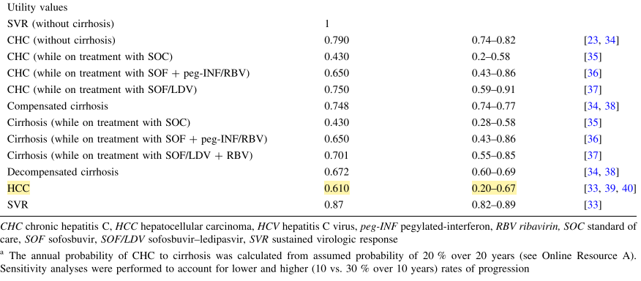
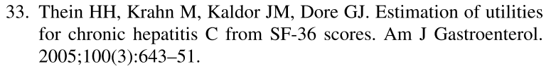
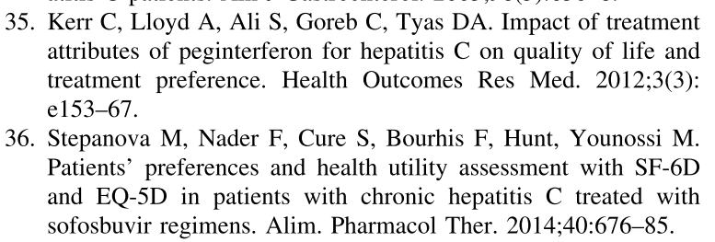
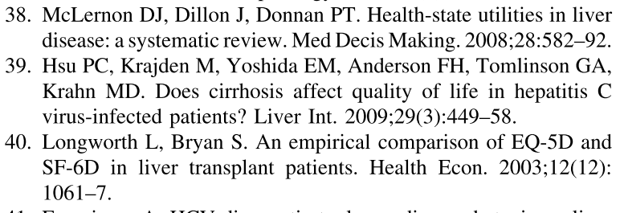
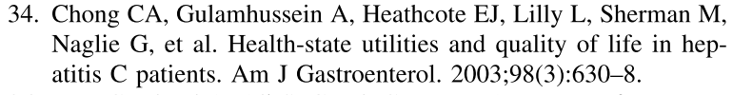
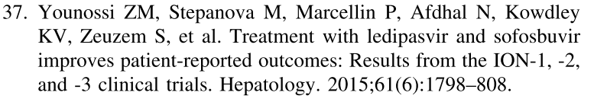
Fraser 2016 Utility values HCV
Disability weights
Utility weights (1-disability weight)
0
0.21
0.57
0.35
0.25
0.252
0.57
0.35
0.299
0.328
0.390
0.13
(with cirrhosis)
Notes:
Fraser 2016 does not have acute HCV patients getting treatment, but we do. Disutility of treatment with acute HCV?
In Fraser 2016, when patients enter treatment they temporarily have a higher disutility weight. I chose the one with the smallest increase in disutility – SOF/LDV. Would you agree with that?
Right now I’m applying the same disutility weights for the subclinical and treatment failure versions of chronic HCV, compensated cirhhosis, and decompensated cirrhosis.
Fraser had a disutility of 0.13 for individuals in sustained viral remission if they developed cirrhosis before they were treated. Currently in our model, once someone clears their infection then they are in the “no infection” state and have no further costs or utility loss. Should I create a new state for people who develop cirrhosis before clearing their infection? If so, do they have annual medical costs related to the cirrhosis we should capture?

Slide 4
HBV Markov diagram disability weights
Acute
SC 0
Immune tolerant SC 0
Immune reactive SC 0.053
Chronic HBeAg- SC 0.0265 (half IR)
CC SC 0.252
DCC SC 0.328
Inactive carrier SC 0
HCC 0.39
HBV death
No infection 0
Inactive carrier CM 0
Acute
CM 0
Immune tolerant CM 0
Immune reactive AVT 0.053
Chronic HBeAg- CM 0.026 5
CC AVT 0.053
DCC AVT 0.127
Chronic HBeAg- AVT 0.053
Should there be any disability for these subclinical states?

Slide 5
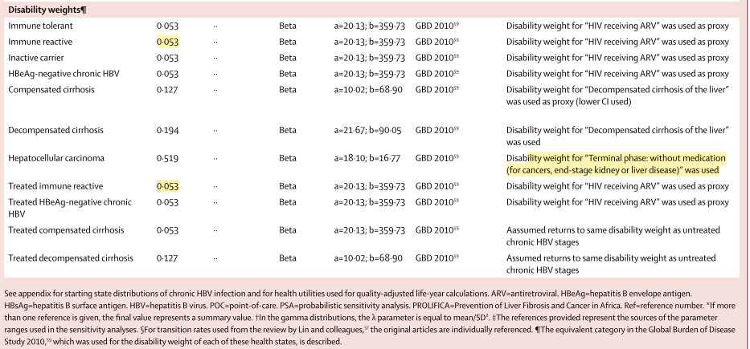
Nayagam 2016 Utility values HBV
Updates in GBD 2013:
HIV receiving ARV is 0.078
Decompensated cirrhosis is 0.178
Terminal phase without medication is 0.569

Slide 6
HCV (Fraser) vs. HBV (Nagayam) utiltiies
CC SC 0.252
DCC SC 0.328
HCC 0.39
CC SC 0.127
DCC SC 0.194
HCC 0.519
CC AVT 0.299
DCC AVT 0.389
CC AVT 0.053
DCC AVT 0.127
CC TF 0.252
DCC TF
0.328

Slide 7
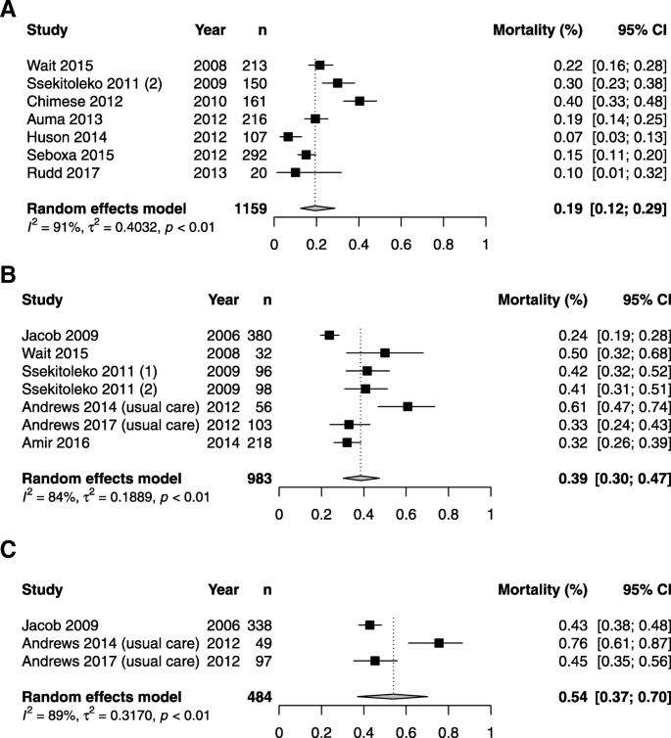
Sepsis mortality
A=in hospital, all sepsis
B=in hospital, severe sepsis
C=30-day severe
https://ccforum.biomedcentral.com/articles/10.1186/s13054-019-2501-y

Slide 8
HCV Markov diagram
Acute
SC
Chronic HCV SC
CC SC
DCC SC
No infection
HCC
HCV death
Acute AVT
Chronic HCV AVT
CC AVT
DCC AVT
Chronic HCV TF
CC TF
DCC TF

Slide 9
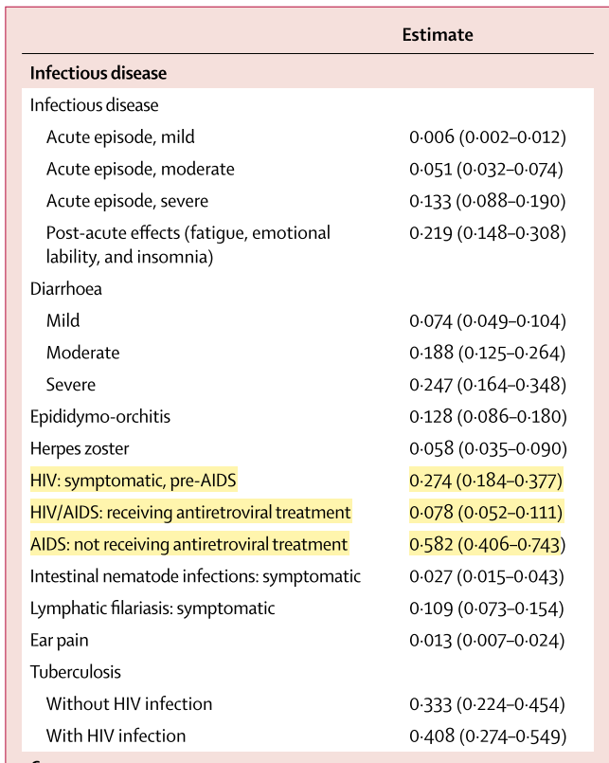

Slide 10
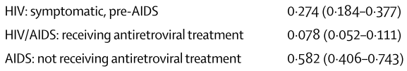
HIV Markov diagram disability weights
HIV UD year 1 0
HIV UD year 2 0
HIV UD year 3+ 0
AIDS UD 0.137
HIV death
AIDS AVT year 1 0.33
HIV AVT year 1 0.127
HIV AVT year 2 0.078
HIV AVT year 3 0.078
65%
AIDS AVT year 2 0.204
HIV AVT year 4+ 0.078
Residual disability
0.204
35%
Global burden of disease 2013 estimates.
Assume no disutility until year AVT initiated
AIDS undetected: 50% HIV symptomatic pre-AIDS
HIV AVT yr 1: 75% “AVT” weight, 25% “symptomatic HIV” weight
AIDS AVT yr 1: 50% “AVT” weight, 50% “AIDS” weight
AIDS AVT yr 2: 75% “AVT” weight, 25% “AIDS” weight
Notes:
AIDS sequelae.
Stroke, neurological problems, cognitive problems.

Slide 11
HIV Markov diagram disability weights
HIV UD year 1 0
HIV UD year 2 0
HIV UD year 3+ 0
AIDS UD 0.137
HIV death
AIDS AVT year 1 $585
HIV AVT year 1 0.127
HIV AVT year 2 0.078
HIV AVT year 3 $57
65%
AIDS AVT year 2 $330
HIV AVT year 4+ $46
Residual disability
$1000-1500
35%
Global burden of disease 2013 estimates.
Assume no disutility until year AVT initiated
AIDS undetected: 50% HIV symptomatic pre-AIDS
HIV AVT yr 1: 75% “AVT” weight, 25% “symptomatic HIV” weight
AIDS AVT yr 1: 50% “AVT” weight, 50% “AIDS” weight
AIDS AVT yr 2: 75% “AVT” weight, 25% “AIDS” weight
Notes:
AIDS sequelae.
Stroke, neurological problems, cognitive problems.
Residual disability: dialysis for HIV patients, physical therapy ~$100/mo. Dialysis: ~$300/month. $1000 - $1500

Slide 12
HIV Markov diagram disability weights
HIV UD year 1 0
HIV UD year 2 0
HIV UD year 3+ 0
AIDS UD 0.137
HIV death
AIDS AVT year 1 30%
HIV AVT year 1 0.127
HIV AVT year 2 0.078
HIV AVT year 3 $57
65%
AIDS AVT year 2 15%
HIV AVT year 4+ $46
Residual disability
15%
35%
Global burden of disease 2013 estimates.
Assume no disutility until year AVT initiated
AIDS undetected: 50% HIV symptomatic pre-AIDS
HIV AVT yr 1: 75% “AVT” weight, 25% “symptomatic HIV” weight
AIDS AVT yr 1: 50% “AVT” weight, 50% “AIDS” weight
AIDS AVT yr 2: 75% “AVT” weight, 25% “AIDS” weight
Notes:
AIDS sequelae.
Stroke, neurological problems, cognitive problems.
Residual disability: dialysis for HIV patients, physical therapy ~$100/mo. Dialysis: ~$300/month. $100 - $1500

Slide 13
HIV Markov diagram
HIV UD yr 1
HIV UD yr 2
HIV UD yr 3+
AIDS UD
HIV death
AIDS AVT yr 1
HIV AVT yr 1
HIV AVT yr 2
HIV AVT yr 3
AIDS AVT yr 2
HIV AVT yr 4+
AIDS AVT residual disability yr 3+

Slide 14
HCV transition matrix

Slide 15
HBV Markov diagram
Acute
SC
Immune tolerant SC
Immune reactive SC
Chronic HBeAg- SC
CC SC
DCC SC
Inactive carrier SC
HCC
HBV death
No infection
Inactive carrier CM
Acute
CM
Immune tolerant CM
Immune reactive AVT
Chronic HBeAg- CM
CC AVT
DCC AVT
Chronic HBeAg- AVT

Slide 16
HBV transition matrix

Slide 17
HIV transition matrix

Slide 18
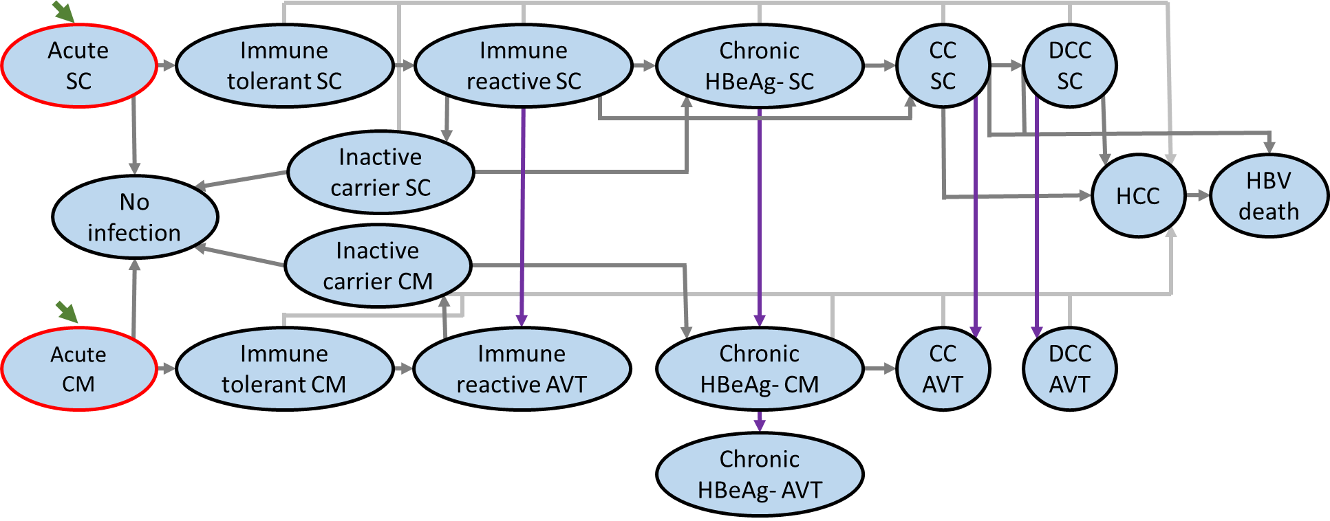
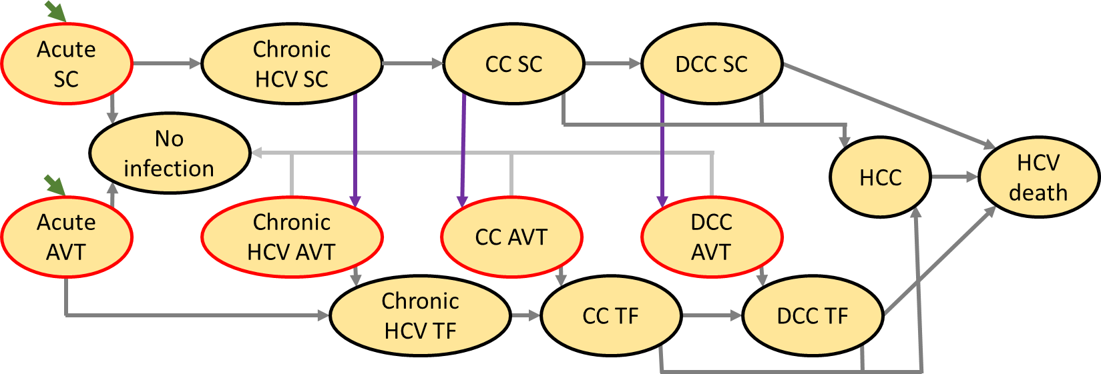
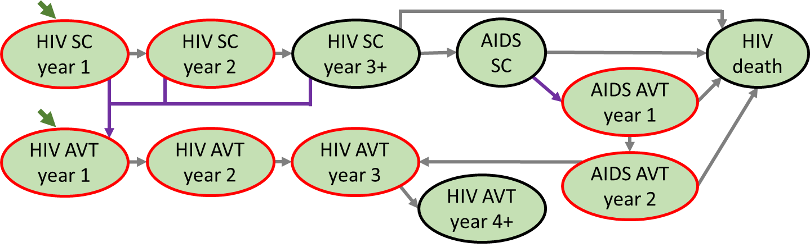
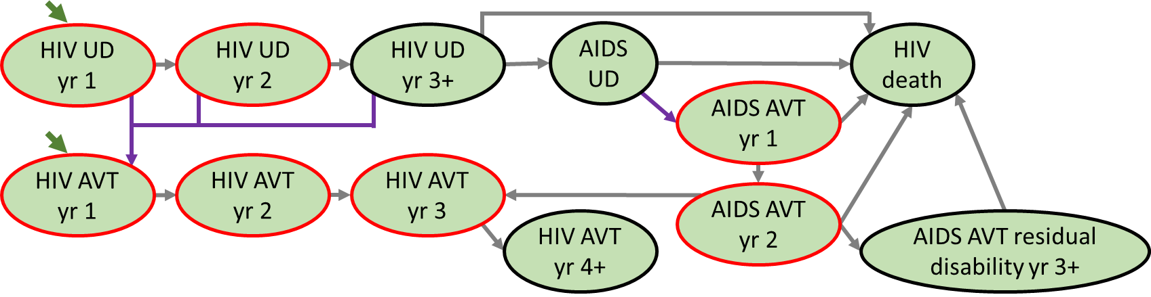
HBV
HCV
Key
Transient state
(no self-loop)
Initial state
Treatment uptake
HIV

Slide 19
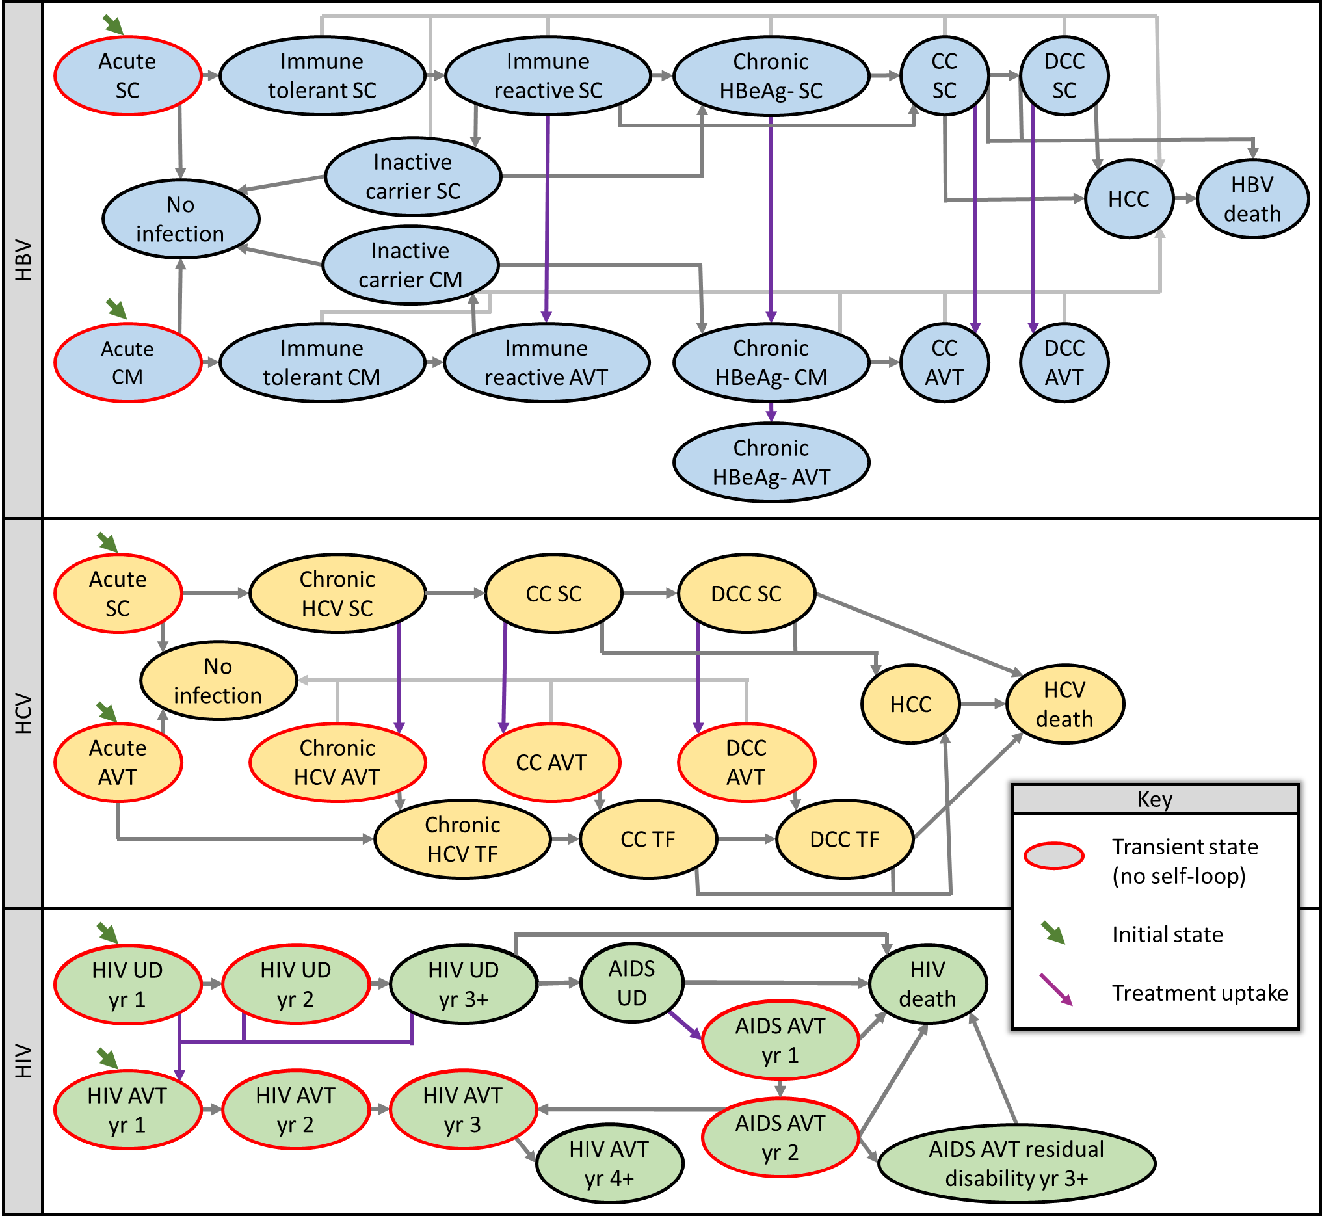

Slide 20
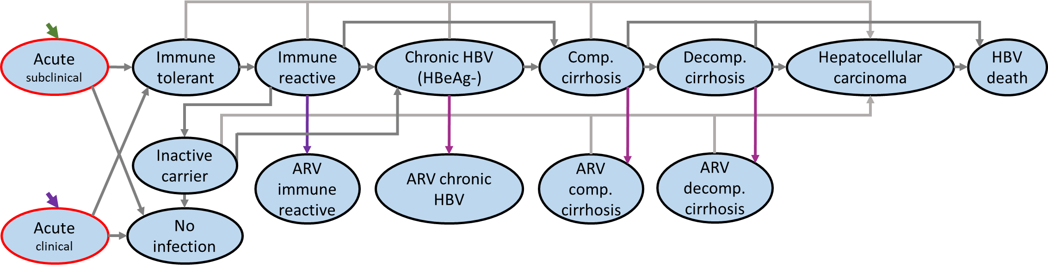
HBV old

Slide 21
Acute
subclinical
Immune tolerant subclinical
Acute
clinical
Immune tolerant clinical
Immune reactive subclinical
Chronic HBV (HBeAg-) subclinical
Comp. cirrhosis
Decomp. cirrhosis
Hepatocellular carcinoma
HBV death
Inactive carrier
Chronic HBeAg- monitor
AVT immune reactive
ARV comp. cirrhosis
ARV decomp. cirrhosis
No infection
Chronic HBeAg- AVT
Clinical acute HBV 10% (0 – 25%)
Immune Reactive subclinical to immune reactive on AVT 5% (10% - 20%)
Chronic HBV to Monitoring 5% (10% - 20%)
Chronic monitoring to AVT no cirrhosis 9% (4% - 18%)
Chronic monitoring to AVT with CC 1% (0.5% - 2%)

